Slide 1
Diyala University
College of Engineering
Department of Civil Engineering
Water Resources Engineering
for 4th Class
By
Dr. Saad Shauket Sammen

Slide 2
1.3 Average Depth of Precipitation
The information on the average depth of precipitation (or rainfall) over a specified area on either the storm basis on seasonal basis or annual basis is often required in several types of hydrologic problems. The depth of rainfall measured by a rain gauge is valid for that rain gauge station and in its immediate vicinity. Over a large area like watershed (or catchment) of a stream, there will be several stations and the average depth of rainfall over the entire area can be estimated by one of the following methods:
1.3.1 Arithmetic Mean Method
This is the simplest method in which average depth of rainfall is obtained by obtaining the sum of the depths of rainfall (say P1, P2, P3, P4 .... Pn) measured at stations 1, 2, 3,..... n and dividing the sum by the total number of stations as shown in equation below

Slide 3
This method is used in regions smaller than 500 km2 when the gauges are rather uniformly distributed.
1.3.2. Theissen Polygon Method
Theissen polygon method takes into account the non-uniform distribution of the gauges by assigning a weightage factor for each rain gauge. This method is more accurate than the arithmetic average method. The procedure to be followed in computing the average rainfall depth is;
Join the adjacent rain-gauge stations A, B, C, D,….. (Figure 1.5) by straight lines.
ii) Draw the perpendicular bisectors of each of these lines.
iii) A Thiessen Polygon is thus constructed. The polygon formed by the perpendicular bisectors around a station encloses an area, which is everywhere closer to that station than any other station. Find the area of each of these polygons.

Slide 4
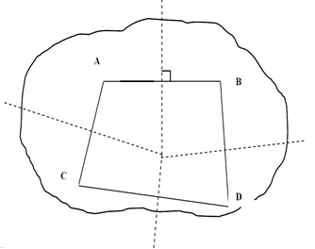
Fig. 1.5 Thiessen Polygon
iv) Multiply the area of each Thiessen polygon by the rainfall value of the enclosed station.
v) Find the total area (ΣA) of the basin.

Slide 5
vi) Compute the average precipitation depth from the equation
Thiessen polygon does not change in time, and is drawn only once. This method can be used in regions 500-5000 km2 size. It considers the non-uniformity of the areal distribution of gauges.

Slide 6
1.3.3. Isohyetal Method
The basic assumption in the Thiessen polygon method is that a rain-gauge station best represents the area, which is close to it. However, this may not be always valid, when the rainfall is controlled by topography or results from intense convection. The Isohyetal method is the most elaborate and accurate in such conditions. An isohyet is a line, on a rainfall map of the basin, joining places of equal rainfall readings. An isohyetal map showing contours of equal rainfall represents a more accurate picture of the rainfall distribution over the basin. The computation steps to be followed for the application of this method are:
From the rainfall values recorded at various rain-gauge stations, the isohyetal map is prepared for the storm causing the rainfall over the area.
ii) Measure the areas enclosed between successive isohyets with the help of planimeter.
iii) Multiply each of these areas by the average rainfall between the isohyets.
iv) The average rainfall is then computed from the expression.

Slide 7
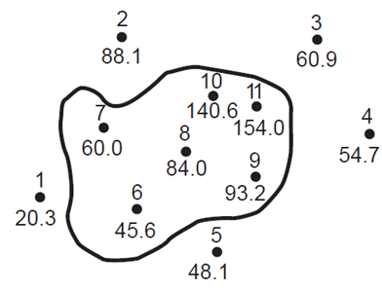
Since this method considers actual spatial variation of rainfall, it is considered as the best method for computing average depth of rainfall.
Example 1: The average depth of annual precipitation as obtained at the rain gauge stations for a specified area are as shown in Figure below. The values are in cms. Determine the average depth of annual precipitation using (i) the arithmetic mean method, (ii) Theissen polygon method, and (iii) isohyetal method.

Slide 8
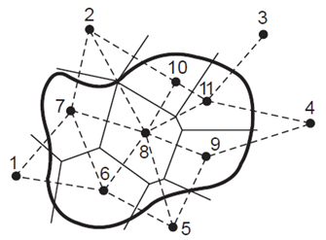
Solution:
(i) Arithmetic mean method :
The average depth of annual precipitation can be determined using the eq.
(ii) Theissen polygons for the given problem have been shown in Figure below and the computations for the average depth of annual precipitation are shown in the following Table below

Slide 9
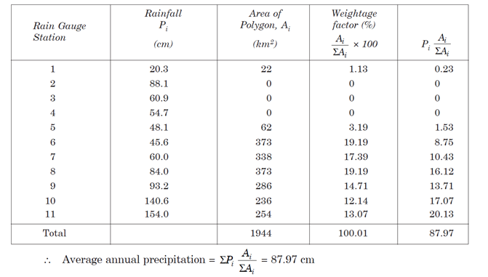

Slide 10
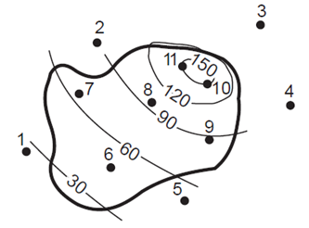
(iii) Isohyetal method: Isohyets are shown in Figure below:
The computations for the average depth of annual precipitation are shown in the following Table below:

Slide 11
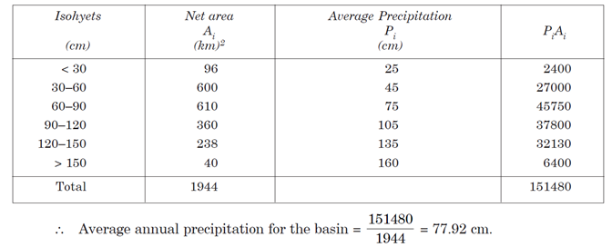

Slide 12
2- Evapotranspiration (Es)
Evapotranspiration include evaporation and transpiration. Evaporation can be defined as the water evaporate from the surfaces of ocean, rivers, and lakes and from the moist soil evaporates. The vapors are carried over the land by air in the form of clouds. While the transpiration is the process of water being lost from the leaves of the plants. Generally, the evapotranspiration consists of
i) Surface evaporation,
ii) Water surface evaporation from river surface and oceans,
iii) Evaporation from plants and leaves (transpiration), and
iv) Atmospheric evaporation.
The rate of evapotranspiration is difficult to quantify, since it can vary considerably from one area to another. An approach to estimate the evapotranspiration over an area is attained by using an evapotranspirometer, which is a container of soil and vegetation from which the water loss is measured by weighting all water inflow from the surface and outflow from the bottom of the container. However, as it is also more convenient for desert regions, the estimation is simplified sometimes by considering losses due to evaporation only.

Slide 13
Equation of continuity may also be used to calculate the evaporation from a water body such as lakes and reservoirs.
E = P + X −Y − F − ΔS
Thus the evaporation rate E in a certain time interval can be computed using the information about precipitation P, inflow X, outflow Y, infiltration F, and the variation of the volume of water ΔS in the same interval.

